Slide 1

Functions and Methods in C# for Unity

Slide 2
Learning Objectives
Understand some Unity-specific methods commonly used in C# scripts.
Understand Coroutine.
Understand Generic functions.
Understand Event functions.
Understand Script Serialization

Slide 3
Content
Methods in Unity
Coroutine
Generic Functions
Event Functions
Script Serialization

Slide 4
Methods in Unity
Some Unity-specific methods commonly used in C# scripts:
Start() and Awake():
Start(): Called once per frame when the script is enabled, after Awake(). It's typically used for initializing variables or setting up references.
Awake(): Called when the script instance is being loaded. It's used for initializing variables or setting up references before Start().
Update():
Called once per frame. It's often used for game logic that needs to be updated continuously, like character movement or input processing.
Image source: Unity.com

Slide 5
Methods in Unity
FixedUpdate():
Called at a fixed time interval, typically used for physics-related calculations. It's more reliable for physics operations than Update().
OnEnable() and OnDisable():
OnEnable(): Called when the object becomes enabled and active.
OnDisable(): Called when the object becomes disabled.
LateUpdate():
Called once per frame after Update(). It's often used for camera-related operations to ensure that all Update() operations have been completed.
Image source: Unity.com

Slide 6
Coroutine
A coroutine is a special type of routine or subroutine in computer programming that allows for non-blocking execution. Unlike regular functions or methods, coroutines can be paused and resumed, allowing the program to perform other tasks while waiting for a particular operation to complete.
Coroutines are often used in scenarios where asynchronous or time-consuming operations need to be performed without freezing the entire program.
Coroutines are commonly used in game development, and Unity, a popular game development engine, has a coroutine system as part of its scripting API. In Unity, coroutines are used to handle tasks such as animations, delays, and other operations that may take time but should not block the main thread.
Image source: Unity.com

Slide 7
Coroutine
The concept of coroutines is not limited to Unity; it exists in various programming languages and frameworks.
Coroutines can simplify asynchronous programming by providing a more readable and structured way to manage asynchronous tasks compared to using callbacks or threads. They are particularly useful in scenarios where you want to avoid the complexity and potential issues associated with multithreading.
Image source: Unity.com

Slide 8
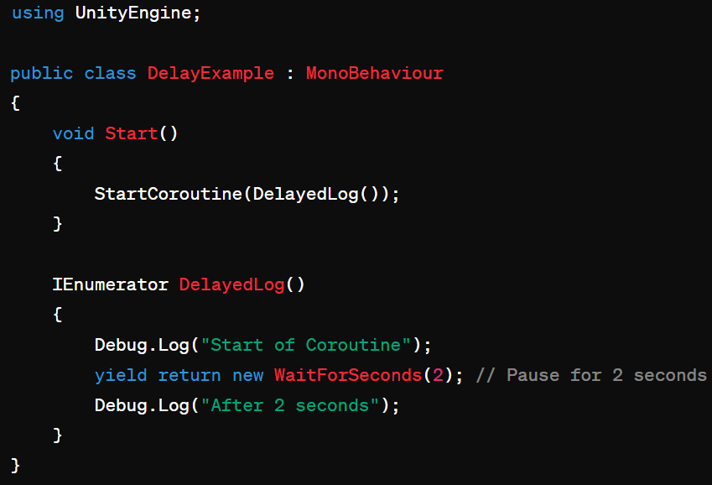
Coroutine
Delaying Execution:
Image source: Unity.com

Slide 9
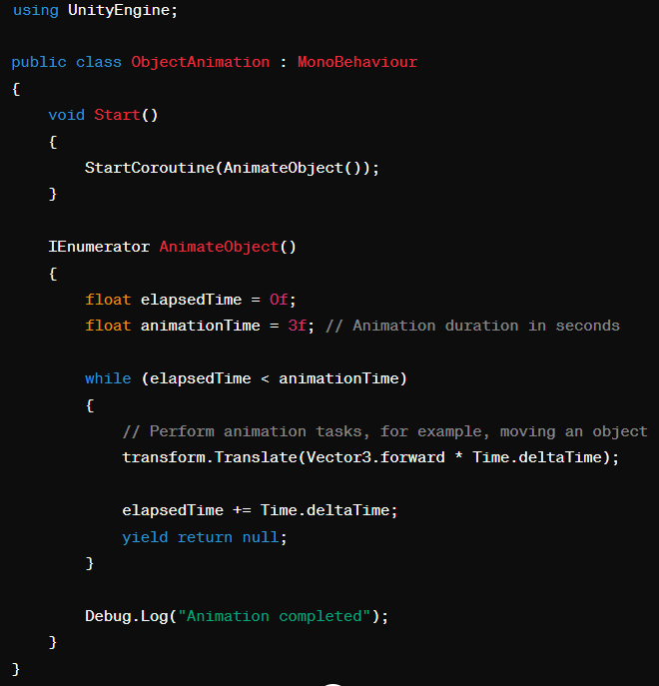
Coroutine
Animating Objects:
Image source: Unity.com

Slide 10
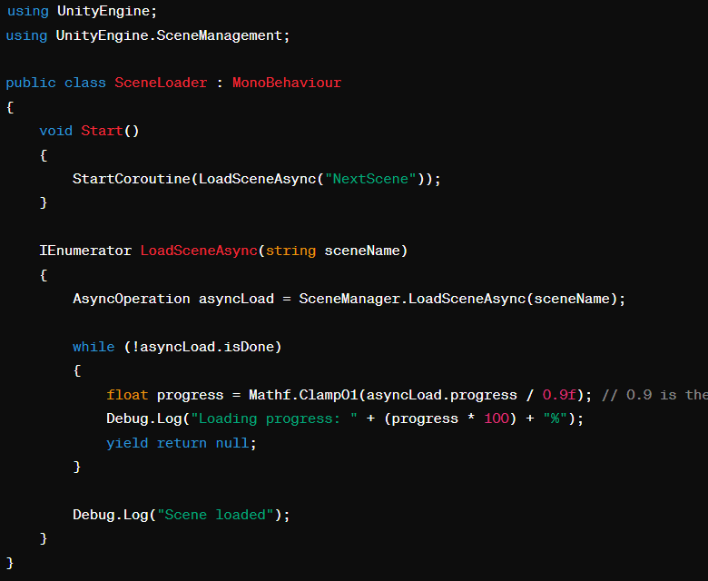
Coroutine
Loading Scenes asynchronously:
Image source: Unity.com

Slide 11
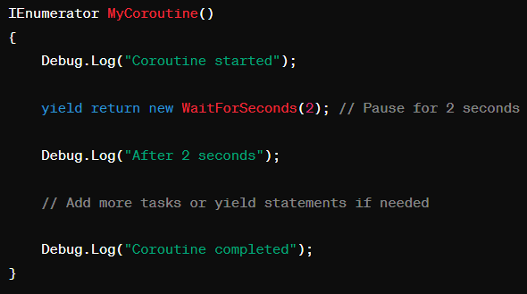
Coroutine
To use coroutines in Unity, you can follow these steps:
Write a Coroutine Function: Create a function with the return type IEnumerator and use the yield return statement to specify the points at which the coroutine should pause and resume. Here's a simple example:
Image source: Unity.com

Slide 12
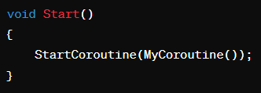
Coroutine
Start the Coroutine: Use the StartCoroutine method to initiate the coroutine. You typically call this method from the Start or Update functions, or in response to an event.
Image source: Unity.com

Slide 13
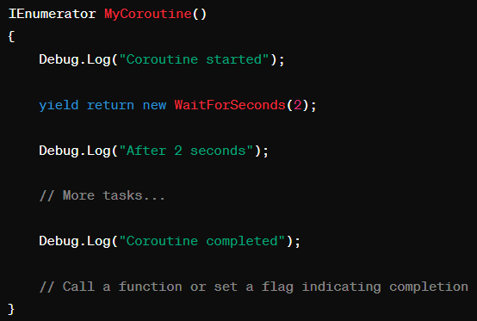
Coroutine
Handle Coroutine Completion (Optional): If you need to perform actions after the coroutine completes, you might want to consider using a callback or checking a flag within the coroutine.
Image source: Unity.com

Slide 14

Coroutine
Stop Coroutine (Optional): If you need to stop a running coroutine prematurely, you can use the StopCoroutine method and pass in the reference to the coroutine
Assuming coroutineReference is a variable storing the reference to the running coroutine
Note: Remember that Unity coroutines run on the main thread, so they are suitable for handling tasks that involve the Unity engine, such as animations, delays, or scene loading. If you need to handle more complex asynchronous operations, you might want to explore Unity's AsyncOperation or use C# features like async and await.
Image source: Unity.com

Slide 15
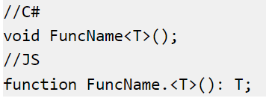
Generic Functions
Some functions in the script reference (for example, the various GetComponent functions) are listed with a variant that has a letter T or a type name in angle brackets after the function name:
These are known as generic functions. The significance they have for scripting is that you get to specify the types of parameters and/or the return type when you call the function.
Image source: Unity.com

Slide 16
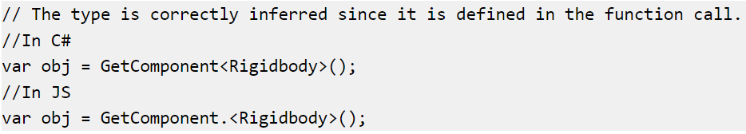
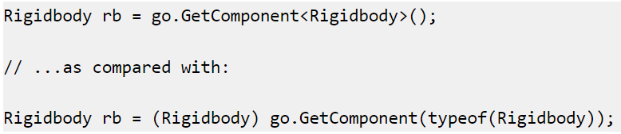
Generic Functions
In JavaScript, this can be used to get around the limitations of dynamic typing:
In C#, it can save a lot of keystrokes and casts:
Image source: Unity.com

Slide 17
Event Functions
In Unity, a script doesn't run continuously like a traditional program. Instead, Unity intermittently passes control to the script by calling specific functions declared within it, known as event functions. These functions respond to gameplay events, and Unity identifies them through a naming scheme. Examples include the Update function (before a frame update) and the Start function (before an object's first frame update).
Many more event functions exist, detailed in the MonoBehaviour class script reference page. The following are some common and important events.
Image source: Unity.com
Notes:
A script in Unity is not like the traditional idea of a program where the code runs continuously in a loop until it completes its task. Instead, Unity passes control to a script intermittently by calling certain functions that are declared within it. Once a function has finished executing, control is passed back to Unity. These functions are known as event functions since they are activated by Unity in response to events that occur during gameplay. Unity uses a naming scheme to identify which function to call for a particular event. For example, you will already have seen the Update function (called before a frame update occurs) and the Start function (called just before the object’s first frame update). Many more event functions are available in Unity; the full list can be found in the script reference page for the MonoBehaviour class along with details of their usage. The following are some of the most common and important events.

Slide 18
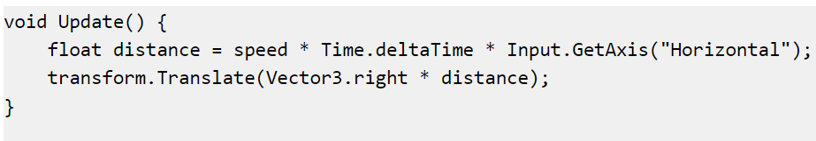
Event Functions
Regular Update Events
A game is rather like an animation where the animation frames are generated on the fly. A key concept in games programming is that of making changes to position, state and behavior of objects in the game just before each frame is rendered. The Update function is the main place for this kind of code in Unity. Update is called before the frame is rendered and also before animations are calculated.
Image source: Unity.com
Notes:
A game is rather like an animation where the animation frames are generated on the fly. A key concept in games programming is that of making changes to position, state and behavior of objects in the game just before each frame is rendered. The Update function is the main place for this kind of code in Unity. Update is called before the frame is rendered and also before animations are calculated.

Slide 19
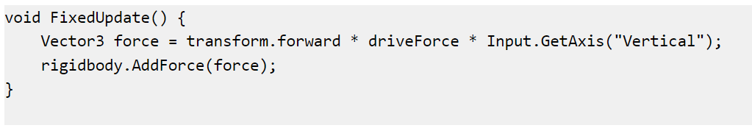
Event Functions
Regular Update Events
The physics engine also updates in discrete time steps in a similar way to the frame rendering. A separate event function called FixedUpdate is called just before each physics update. Since the physics updates and frame updates do not occur with the same frequency, you will get more accurate results from physics code if you place it in the FixedUpdate function rather than Update.
Image source: Unity.com
Notes:
The physics engine also updates in discrete time steps in a similar way to the frame rendering. A separate event function called FixedUpdate is called just before each physics update. Since the physics updates and frame updates do not occur with the same frequency, you will get more accurate results from physics code if you place it in the FixedUpdate function rather than Update.

Slide 20
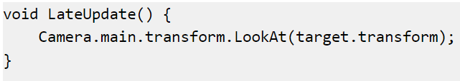
Event Functions
Regular Update Events
LateUpdate is handy for making additional changes after Update and FixedUpdate functions, such as adjusting a camera's orientation after a target object has moved or overriding animation effects in script code, like making a character's head look towards a target object.
Image source: Unity.com
Notes:
It is also useful sometimes to be able to make additional changes at a point after the Update and FixedUpdate functions have been called for all objects in the scene and after all animations have been calculated. An example is where a camera should remain trained on a target object; the adjustment to the camera’s orientation must be made after the target object has moved. Another example is where the script code should override the effect of an animation (say, to make the character’s head look towards a target object in the scene). The LateUpdate function can be used for these kinds of situations.

Slide 21
Event Functions
Initialization Events
Initialization code before gameplay updates is crucial. Start is called before the first frame or physics update, while Awake is called for each scene object at scene load. Although Start and Awake order is arbitrary, all Awake functions finish before the first Start, allowing Start code to utilize prior initializations in the Awake phase.
Image source: Unity.com
Notes:
It is often useful to be able to call initialization code in advance of any updates that occur during gameplay. The Start function is called before the first frame or physics update on an object. The Awake function is called for each object in the scene at the time when the scene loads. Note that although the various objects’ Start and Awake functions are called in arbitrary order, all the Awakes will have finished before the first Start is called. This means that code in a Start function can make use of other initializations previously carried out in the Awake phase.

Slide 22
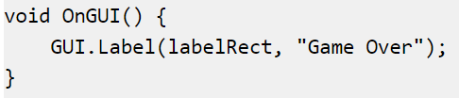
Event Functions
GUI events
Unity has a system for rendering GUI controls over the main action in the scene and responding to clicks on these controls. This code is handled somewhat differently from the normal frame update and so it should be placed in the OnGUI function, which will be called periodically.
Detect mouse events over a GameObject for actions like targeting or displaying character information. OnMouseXXX event functions (e.g., OnMouseOver, OnMouseDown) enable scripts to react to mouse actions. For instance, if the mouse button is pressed over an object, the object's script's OnMouseDown function is called if it exists.
Image source: Unity.com
Notes:
Unity has a system for rendering GUI controls over the main action in the scene and responding to clicks on these controls. This code is handled somewhat differently from the normal frame update and so it should be placed in the OnGUI function, which will be called periodically.
You can also detect mouse events that occur over a GameObject as it appears in the scene. This can be used for targeting weapons or displaying information about the character currently under the mouse pointer. A set of OnMouseXXX event functions (eg, OnMouseOver, OnMouseDown) is available to allow a script to react to user actions with the mouse. For example, if the mouse button is pressed while the pointer is over a particular object then an OnMouseDown function in that object’s script will be called if it exists.

Slide 23
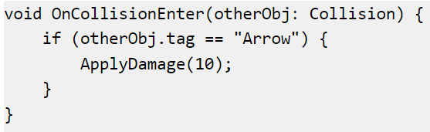
Event Functions
Physics events
The physics engine triggers event functions in an object's script for collisions. OnCollisionEnter, OnCollisionStay, and OnCollisionExit signal contact events, while OnTriggerEnter, OnTriggerStay, and OnTriggerExit are for Trigger colliders. These functions provide collision details when multiple contacts occur during a physics update, passing parameters like collision position and incoming object identity.
Image source: Unity.com
Notes:
The physics engine will report collisions against an object by calling event functions on that object’s script. The OnCollisionEnter, OnCollisionStay and OnCollisionExit functions will be called as contact is made, held and broken. The corresponding OnTriggerEnter, OnTriggerStay and OnTriggerExit functions will be called when the object’s collider is configured as a Trigger (ie, a collider that simply detects when something enters it rather than reacting physically). These functions may be called several times in succession if more than one contact is detected during the physics update and so a parameter is passed to the function giving details of the collision (position, identity of the incoming object, etc).

Slide 24
Script Serialization
Serialization is the automatic process of transforming data structures or object states into a format that Unity can store and reconstruct later.
Some of Unity’s built-in features use serialization; features such as saving and loading, the Inspector window, instantiation, and Prefabs.
How you organise data in your Unity project affects how Unity serializes that data and can have a significant impact on the performance of your project. The next slides are some guidance on serialization in Unity and how to optimize your project for it.
Image source: Unity.com

Slide 25
Script Serialization
Hot reloading
Hot reloading is the process of creating or editing scripts while the Editor is open and applying the script behaviors immediately. You do not have to restart the game or Editor for changes to take effect.
When you change and save a script, Unity hot reloads all the currently loaded script data. It first stores all serializable variables in all loaded scripts and, after loading the scripts, it restores them. All data that is not serializable is lost after a hot reload.
Saving and loading
Unity uses serialization to load and save Scenes, Assets, and AssetBundles to and from your computer’s hard drive. This includes data saved in your own scripting API objects such as MonoBehaviour components and ScriptableObjects.
Many of the features in the Unity Editor build on top of the core serialization system. Two things to be particularly aware of with serialization are the Inspector window, and hot reloading.
Image source: Unity.com

Slide 26
Script Serialization
The Inspector window
When you view or change the value of a GameObject’s component field in the Inspector window, Unity serializes this data and then displays it in the Inspector window. The Inspector window does not communicate with the Unity Scripting API when it displays the values of a field.
If you use properties in your script, any of the property getters and setters are never called when you view or change values in the Inspector windows as Unity serializes the Inspector window fields directly. This means that: While the values of a field in the Inspector window represent script properties, changes to values in the Inspector window do not call any property getters and setters in your script
Image source: Unity.com

Slide 27
Script Serialization
Serialization rules
Serializers in Unity run in a real-time game environment. This has a significant impact on performance. As such, serialization in Unity behaves differently to serialization in other programming environments. Outlined below are a number of tips on how to use serialization in Unity.
How to ensure a field in a script is serialized
Ensure it:
Is public, or has a SerializeField attribute
Is not static
Is not const
Is not readonly
Image source: Unity.com

Slide 28
Script Serialization
Has a fieldtype that can be serialized:
Primitive data types (int, float, double, bool, string, etc.)
Enum types (32 bits or smaller)
Fixed-size buffers
Unity built-in types, for example, Vector2, Vector3, Rect, Matrix4x4, Color, AnimationCurve
Custom structs with the Serializable attribute
References to objects that derive from UnityEngine.Object
Custom classes with the Serializable attribute. (See Serialization of custom classes).
An array of a field type mentioned above
A List<T> of a field type mentioned above
Image source: Unity.com

Slide 29
Script Serialization
Note: Unity doesn’t support serialization of multilevel types (multidimensional arrays, jagged arrays, dictionaries, and nested container types). If you want to serialize these, you have two options:
Wrap the nested type in a class or struct
Use serialization callbacks, by implementing ISerializationCallbackReceiver, to perform custom serialization.
Image source: Unity.com

Slide 30
Script Serialization
Serialization of custom classes
For Unity to serialize a custom class, you must ensure the class:
Has the Serializable attribute
isn’t static.
When you assign an instance of a UnityEngine.Object-derived class to a field and Unity saves that field, Unity serializes the field as a reference to that instance. Unity serializes the instance itself independently, so it isn’t duplicated when multiple fields are assigned to the instance. But for custom classes which don’t derive from UnityEngine.Object, Unity includes the state of the instance directly in the serialized data of the MonoBehaviour or ScriptableObject that references them.
Image source: Unity.com

Slide 31
Script Serialization
Serialization of custom classes
There are two ways that this can happen:
Inline serialization: By default, Unity serializes custom classes inline by value when you don’t specify [SerializeReference] on the field that references the class. This means that if you store a reference to an instance of a custom class in several different fields, they become separate objects when serialized. Then, when Unity deserializes the fields, they contain different distinct objects with identical data.
[SerializeReference] serialization: If you do specify [SerializeReference], Unity establishes the object as a managed reference. The host object still stores the objects directly in its serialized data, but in a dedicated registry section.
Image source: Unity.com

Slide 32
Script Serialization
Serialization of custom classes
[SerializeReference] adds some overhead but supports the following cases:
Handling null fields: [SerializeReference] supports fields that can be null, unlike inline serialization which replaces null with an inline object with unassigned fields.
Managing multiple references: Without [SerializeReference], storing a reference to an object in different fields results in separate objects when serialized.
Dealing with graphs and cyclical data: [SerializeReference] is essential for handling cycles in data, preventing unexpected issues like strange Inspector behavior, console errors, or infinite loops.
Ensuring polymorphism: When using [SerializeReference], Unity correctly serializes fields of both the parent and derived classes, preventing issues during deserialization.
Providing stable identifiers: [SerializeReference] is useful when a data structure requires a stable identifier to point to a specific object without hardcoding its array position or searching the entire array. Check Serialization.ManagedReferenceUtility.SetManagedReferenceIdForObject for more details.
Image source: Unity.com

Slide 33
Script Serialization
Serialization best practice
Optimize Unity's serialization by aiming for the smallest data sets. This isn't about saving disk space but ensuring backward compatibility.
Avoid serializing duplicate or cached data to prevent errors in backward compatibility.
Also, steer clear of nested, recursive structures referencing other classes. Serialized structures should have a consistent layout, only dependent on script exposure, and use classes derived from UnityEngine.Object to reference other classes without embedding contents.
Image source: Unity.com
Notes:
You can organize your data to ensure you get optimal use of Unity’s serialization.
Aim to have Unity serialize the smallest possible set of data. The purpose of this isn’t to save space on your computer’s hard drive, but to make sure that you can maintain backwards compatibility with previous versions of the project. Backwards compatibility can become more difficult later on in development if you work with large sets of serialized data.
Never have Unity serialize duplicate data or cached data. This causes significant problems for backwards compatibility: it carries a high risk of error because data can get out of sync.
Avoid nested, recursive structures where you reference other classes. The layout of a serialized structure always needs to be the same; independent of the data and only dependent on what’s exposed in the script. The only way to reference other classes is through classes derived from UnityEngine.Object. These classes are separate; they only reference each other and they don’t embed the contents.

